Slide 1
Market Analysis 5
Judha, Amy, Victoria
December 2, 2022
Notes:
Change the slide background colour to any of the Primary colours (except yellow)

Slide 2
SCOTIABANK DIGITAL BANKING DECK TEMPLATE
Agenda
01
02
03
Macroeconomics Update
ESG Investing – what is it?
ESG Politics and Investment Outlook

Slide 3

Update on top 3 for our Investopedia Trading

Slide 4




00 SUBSECTION NAME
4
Update

Slide 5
01
At a crossroad
Notes:
Don’t be afraid to change the background colours! Under the ”design” tab select “format background”. Change the background colour to one of the fun new Scotia colours!

Slide 6
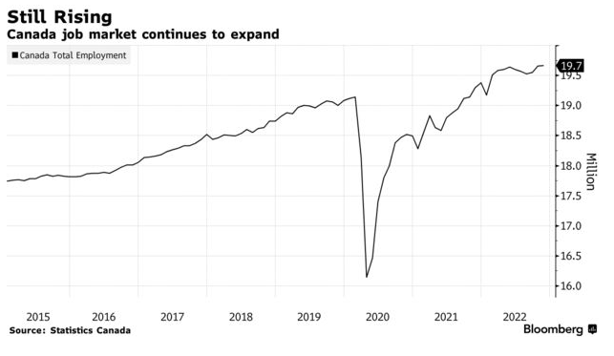
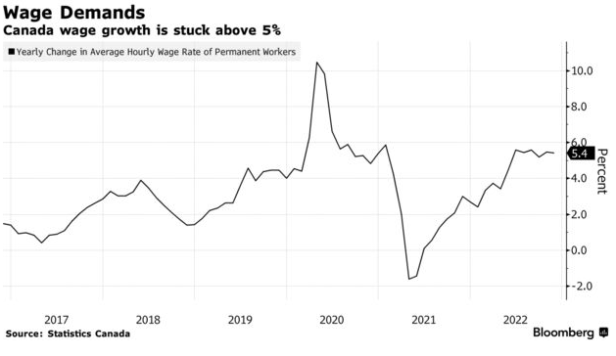
00 SUBSECTION NAME
6
6
Economy not slowing down
The economy is not slowing down enough.
More jobs added again.
Only in Ontario, Quebec, and Nova Scotia
Average Hourly Pay up over 5% again
https://www.bloomberg.com/news/articles/2022-12-02/canada-adds-10-000-jobs-unemployment-rate-falls-to-5-1

Slide 7
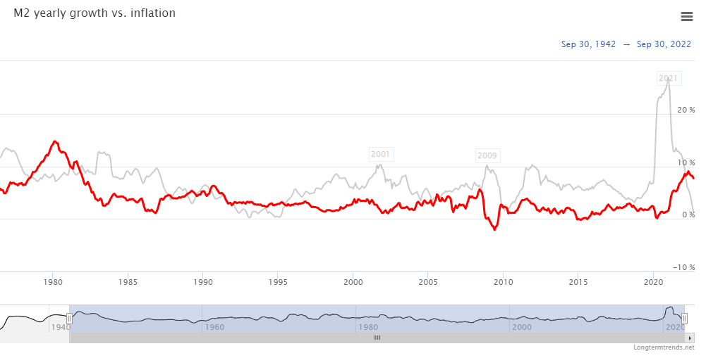
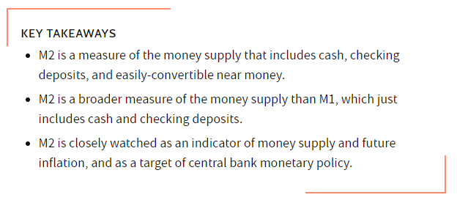
00 SUBSECTION NAME
Longest Growth Cycle Ever… What’s next?
Flattening Inflation, money supply
Unbalanced economy
Lowered interest rates
Increased M2
Lowered real world supply
Supply chain pain
Labor
Retirements
Lockdowns
Deaths
No easy fix
Note: USA numbers

Slide 8
02
ESG Investing
Notes:
Don’t be afraid to change the background colours! Under the ”design” tab select “format background”. Change the background colour to one of the fun new Scotia colours!

Slide 9
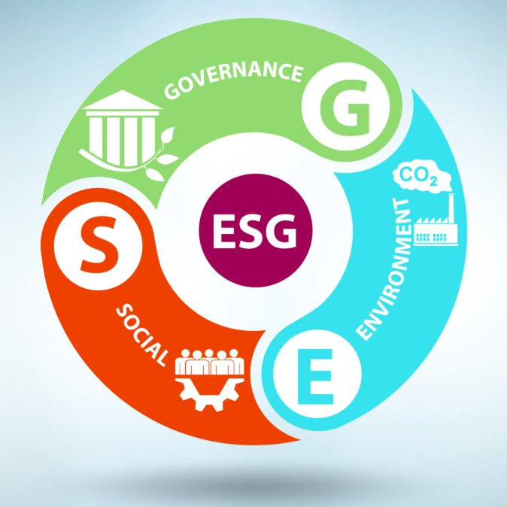
What is ESG?
00 SUBSECTION NAME
9
9
ESG stands for
Environment, Social, and Governance
-ESG helps to make a positive environmental impact, social impact, and culture impact
-Environmental(E) means the energy use, waste, pollution a company contributes to the planet
-Social(S) means how the company is managing its relationship internally and externally (ex. culture, reputation)
-Governance(G) means the way the company is regulating, usually diversity, leadership structure, and reliable regulation

Slide 10
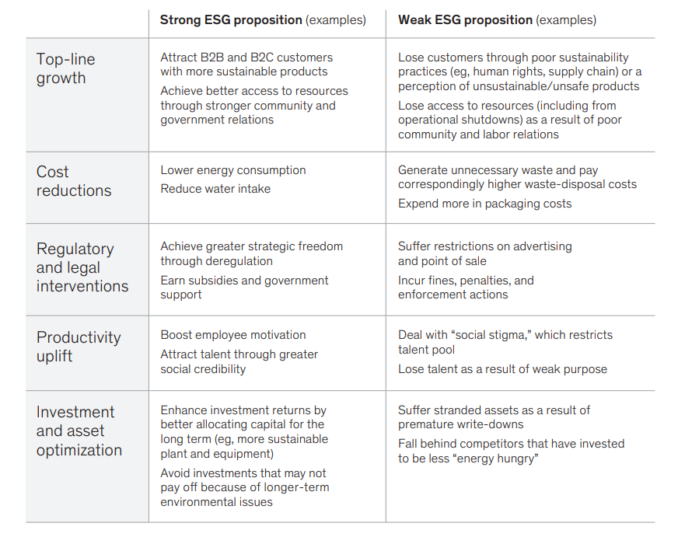
How does ESG impact investing decision?
00 SUBSECTION NAME
-ESG creates positive reputation and loyal customers for a company
-Provides comparative advantage
-Sustainability report
-Investors often look at those to evaluate the risk and potential growth for investing
-Usually guaranteed return

Slide 11
ESG Investing: Benefits
GOALS
Investors can support companies that share the same values, goals, and long-term outlook (e.g., companies working towards net-zero greenhouse gas emissions, decarbonization of assets, data privacy improvement, diversity, etc.
With the rise in ESG-exposed companies and ESG investment funds, people can their money where their values are
REDUCE RISK
Being conscious of ESG helps investors avoid company scandals, investigations, or lawsuits
ESG-exposed companies are more conscious of their ecological footprint, sustainable operating, ethical policies, and a diverse and transparent senior management team and BOD
WHAT ABOUT DIVESTING?
Divesting is the opposite of investing – when investors reduce or dump investment due to ESG-related concerns
Discussion: what are your thoughts on divesting – can it be seen as a benefit?

Slide 12
ESG Investing: Drawbacks
GREENWASHING
With increasing emphasis and interest placed on ESG investing, greenwashing has become an issue
Greenwashing is using marketing or PR techniques to suggest a company/product is more eco-friendly than it really is
Infamous example: 2015 Volkswagen Emissions Scandal – Volkswagen used a “diesel dupe” device to alter emission tests
RETURNS
Another concern is returns – many believe that socially-responsible investing comes at a cost, that is, lower returns
Example to dispute: JUST U.S. Large Cap Diversified Index (JULCD) which outperformed Russel 1000 for 3 consec. Years
In terms of ESG-investments, they tend to trade at a premium, which suggests it is more expensive than traditional styles
DIVERSIFICATION
Others question if ESG-investing can obtain true diversification
ESG-investing refrains from holding shares in industries such as tobacco, defense (weapons), etc.

Slide 13
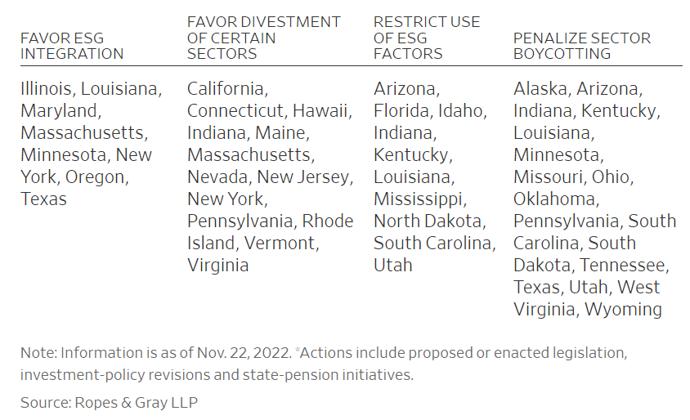
ESG Politics
ESG has become a political issue, due to its affiliation with topics such as the climate crisis, ethical supply chains, racial inequality, etc.
BLACKROCK
BlackRock is the world’s largest asset manager, and they manage many government investments in the U.S., including state pensions
On Thursday, Florida pulled $2B out of BlackRock due to their support for ESG
This follows other Republican states, such as Louisiana, who have pulled funds
In contrast, Democrat states, such as New York, have supported the incorporation of ESG-goals into pension investment policies

Slide 14
ESG has been a rising topic over the past years
If the trend continues, we will see more ESG integration in institutional investing and more ESG-index funds
Forbes describes ESG-investing as “the trend of the decade” and notes how ESG funds doubled from 2020 to 2021
Morningstar found that ESG funds exhibit lower volatility and better longevity
In the age of emerging tech, there will be new metrics to determine ESG ratings – perhaps with AI applications and data science
With investor/public demand, more companies will adopt practices such as publishing sustainability reports, improving public image/values, etc.
Outlook

